Slide 1


Scoping Review on the Well-being of Childless Women and Men in Older Age
Ivett Szalma – Judit Takács- Lóránt Pélyi
European Sociological Association (ESA) RN13 Sociology of Families and Intimate Lives Interim Meeting 2025, Ankara, Turkey

Slide 2
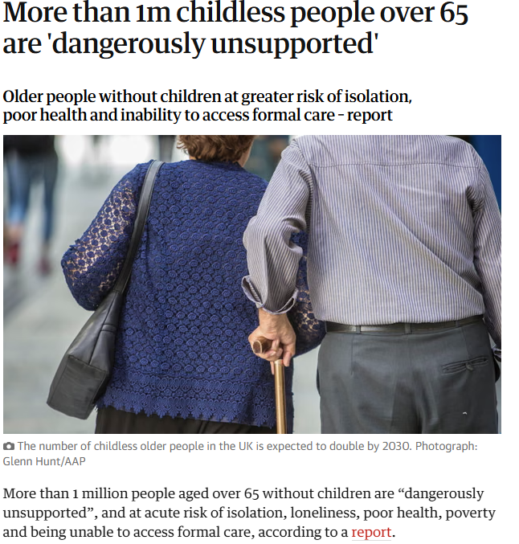

Relevance
Population aging is reshaping the structure and support systems of families in Europe.
A growing number of adults reach older age without having children.
Social norms and policies often assume the presence of children in later life.
Childless older adults may face unique challenges in terms of care, financial security, and social support.
Existing research is fragmented and lacks a comprehensive overview of this population’s well-being.
This review identifies and synthesizes current knowledge to inform social policy and future research.

Slide 3
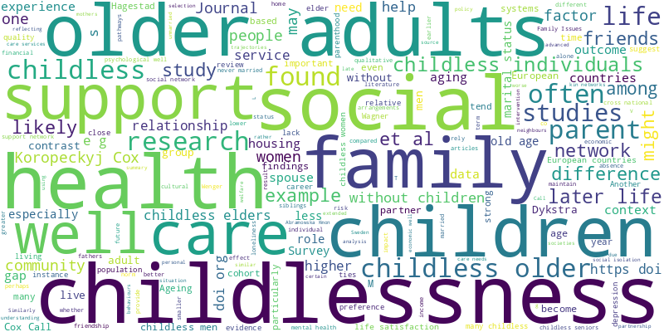
Research question and methods
How does childlessness affect different dimensions of well-being in old age (50+)?
Scoping review: English-language articles published between 2000 and 2025 in a European context
Databases: Scopus and Web of Science
Exclusion criteria (e.g., younger populations, irrelevant topics)

Slide 4
Search terms
Keywords | Scopus |  | Web of science
 | Total number of search results | Number of relevant articles | Total number of search results | Number of relevant articles
Childlessness/childfree and network | 76 | 31 | 120 | 8
Childlessness/childfree and wellbeing | 112 | 17 | 131 | 6
Childlessness and quality of life | 23 | 5 | 64 | 4
Childlessness and loneliness | 245 | 18 | 182 | 3
Childlessness and support | 354 | 10 | 381 | 11
Older adults and childlessness | 352 | 14 | 653 | 18
Childlessness and later life | 44 | 6 | 78 | 1
Childlessness and life satisfaction | 46 | 5 | 57 | 0
Childlessness and lifelong | 19 | 0 | 26 | 0
Childlessness and exclusion | 21 | 0 | 14 | 0

Slide 5
Prisma Flow Diagram
Distribution of Articles by Publication Year
Records identified through database searching
(n=2998)
Additional records identified through other sources
(n=2)
Identification
Records after duplicates removed
(n=1155)
Screening
Records screened
(n =1155)
Records excluded
(n=996)
Full-text articles assessed for eligibility
(n=159)
Full-text articles excluded with reasons
(n=51)
Eligibility
Studies included
(n =108)
Included

Slide 6
Emergent Themes (6)
Socio-demographic factors: partnership status, gender differences, social class, involuntary -voluntary, sexual orientation
Mental health and psychological well-being, coping strategies and social participation
Social relationships and networks, social capital
Health and care needs and types of available support
Economic well-being and housing, and care preferences
Role of social and cultural context, stigmatization

Slide 7
Socio-Demographic Factors
Gender: Childless older men, especially those without a partner, tend to experience worse emotional well-being and smaller support networks than women (Dykstra & Hagestad, 2007; Wenger, 2021).
Being married strongly mitigates the negative effects of childlessness, providing emotional and financial stability and reducing loneliness (Hank & Wagner, 2013; Keizer et al., 2010).
Educational attainment also plays a key role: highly educated childless women from earlier cohorts often achieved greater financial security and autonomy, offsetting potential disadvantages (Koropeckyj-Cox & Call, 2007; Umberson et al., 2010).
Cohort differences matter too: younger generations tend to experience childlessness more positively, due to greater societal acceptance. (Koropeckyj-Cox & Call, 2007).
Childless older adults are a highly diverse group, and their well-being depends on intersecting life circumstances rather than childlessness alone.

Slide 8
Economic Well-Being
Childless older adults are often disadvantaged in wealth accumulation (Van Winkle & Monden, 2022 – longitudinal SHARE data, 2011–2017, 14 European countries, 39,177 individuals aged 50–65).
  Main reasons: weaker savings motivation and state policies disproportionately favoring parents (Van Winkle & Monden, 2022).
  The “two-child family” represents the optimal pathway, showing the strongest wealth accumulation (Van Winkle & Monden, 2022).
  Childless adults face higher risks of asset poverty and indebtedness (Kolk, 2023 – Swedish administrative register data on lifetime income, cohorts born 1940–1970, tracking accumulation between ages 20–60).

Slide 9
Economic Well-Being: alternative patterns
Not all childless individuals are disadvantaged; some benefit economically (Muller et al., 2020 – GGS, BHPS, and SHARELIFE; retrospective life-course data for 18,656 women aged 50–59 in 22 European countries; sequence cluster analysis + regressions).
  Childless women, especially those without partners, often achieve higher earnings than mothers due to uninterrupted careers (Muller et al., 2020).
  Among men, childlessness is more often associated with lower incomes compared to fathers (Keizer et al., 2010 – Netherlands Kinship Panel Study, first wave 2002–2004, 1,451 Dutch men aged 40–59, analysis of income differences by parental status).
  Marital status strongly mediates outcomes: marriage provides an economic buffer for childless adults (Koropeckyj-Cox & Call, 2007 – comparative survey across 7 countries, 1990–1994, examining links between marital/parental status and later-life income).

Slide 10
Economic Well-Being: housing and care preferences
Childless older adults are more likely to live alone than parents (Reher & Requena, 2007). However, they face higher risks of institutionalization compared to parents (Coropeckyj-Cox & Call, 2007: 7-country survey, 1990–1994).
  Childless seniors rely more heavily on formal care services (Vicente & Guadalupe, 2022 – cross-sectional survey in Portugal, N=612 aged 65+, of which 72 childless; analysis of social networks and care reliance).
  Wenger (2009): 20-year longitudinal study in rural North Wales (1979–1999) following 209 adults aged 85+. It tracked informal support networks and transitions into residential care, finding that many childless—especially ever-married women—lived alone, and that residential care became the predominant end-of-life setting as health declined.
  LGBT+ seniors prefer identity-sensitive housing and care arrangements (Lottman & King, 2022 – qualitative research on older LGBT+ adults’ housing and caregiving preferences, focus on safety and community).

Slide 11
Understanding social capital in later life
Without children → absence of vertical familial support.
  SHARE survey, 11 European countries → intergenerational support flows present among parents, absent among the childless (Deindl & Brandt, 2017).
  Friendships, neighbourhood ties, voluntary associations → alternative sources of support
    British Household Panel Survey, UK → stronger reliance on kin among working class; childlessness compounds disadvantage (Gray, 2009).
    Qualitative interviews, UK → childless women are more successful than men in building extra-familial networks (Wenger et al., 2000).
    Longitudinal studies, UK → men rely heavily on spouses, risk isolation when widowed (Wenger, 2009).
    Comparative EU study → Southern Europe: reliance on extended family; Western Europe/North America: reliance on friends/non-kin (Banks et al., 2009).
    Qualitative research, US/Western Europe → LGBT older adults depend on “families of choice” (Wilkens, 2015; Lottmann & King, 2022).

Slide 12
Deficit and/or Opportunity?
Deficit – vulnerability without intergenerational ties
  Rural Wales (Wenger, 2001) → Qualitative studies show that when health declines, the absence of children leaves older adults highly vulnerable, since kin-based support is often irreplaceable.
  Cross-national SHARE survey (Deindl & Brandt, 2017) → Across European countries, childless older people are more likely to experience a “care gap” when they become frail, meaning they may lack practical support that children usually provide.
  Opportunity – alternative pathways of integration
    Qualitative research in Western Europe show how older lesbians and involuntarily childless men construct “fictive kin” and community groups that both provide emotional support and challenge exclusion. (Wilkens, 2015; Hadley, 2021).
    Surveys show that childless older adults are disproportionately active in volunteering and philanthropy, creating bridging and linking capital that strengthens community belonging. (Albertini & Kohli, 2009; Albertini & Mencarini, 2014)

Slide 13
Substitution Mechanisms
Two main strategies
  Childless older adults often build larger, more diverse networks (friends, neighbours, extended kin) (Schnettler & Wöhler, 2016).
  Another strategy: fewer but more intensive, high-quality ties (Mair, 2019).
  Limitations
    Close ties cannot fully substitute long-term intensive care (Mair, 2019).
    In Portugal, formal services are essential when kin are distant or unavailable (Vicente & Guadalupe, 2022).
    BUT! Younger cohorts (lower fertility, more tolerant norms) → stronger non-kin networks (Schnettler & Wöhler, 2016; Klaus & Schnettler, 2016).
    Policy implication
    Need to expand community programs, strengthen formal care, and support new living arrangements (Vicente & Guadalupe, 2022; Sauter et al., 2024).

Slide 14
Reproductive History and Later-Life Health
Substantial evidence links fertility history with long-term health.
Read et al. (2011): British Household Panel Survey (1992–2003), 3,450 British women and men (born 1923–1949).
  Childless women more likely to report activity-limiting health problems compared to mothers of two.
  Health limitations accumulated faster among childless women; no significant association for men.
  Emotional support, SES, and smoking only partly explained these disadvantages.

Slide 15
Childlessness and Mortality
Einiö et al. (2016, Finland): 1950 Census 10% sample, 87,573 men and women (born 1938–1950).
  Childless men and women had higher mortality risk, especially if unpartnered or chronically ill.
  Among men: highest mortality due to cardiovascular disease, alcohol-related causes, and accidents.
Quashie et al. (2021): Health and Retirement Study (HRS) family, 20 countries, 109,648 adults aged 50+.
  Country variation: health advantage for childless in Hungary & Mexico; disadvantage in Netherlands & Czechia.
  Lack of family support is a key factor in survival and care once illness occurs.

Slide 16
Voluntary vs. Involuntary Childlessness in Cultural Context
Western European societies
    Parenthood = core of adult identity; childlessness seen as deviance/selfishness till middle of XX. century in Western Societies (Letherby, 2002; Dykstra & Hagestad, 2007).
    Childless women once “selfish/incomplete”; now alternative “doing family” practices (Letherby, 2002; Blackstone, 2014).
Eastern European societies
    Poland and Lithuania: voluntary childlessness → selfishness, “incomplete life”; involuntary → empathy but “deficiency” (Świątkiewicz & Wacławik, 2013; (Gedvilaite-Kordusiene et al., 2020).

Slide 17
Regional Differences & Welfare Regimes
Northern & Western Europe
  SHARE Wave 6, 2015, 17 countries – kinlessness ≠ isolation; friendships & community ties can replace kin support (Mair, 2019).
  European Social Survey, 2006–2008, multiple EU countries – public care in Scandinavian/Anglophone contexts reduces disadvantages of childlessness (Albertini & Mencarini, 2014).
Southern & Eastern Europe
  Spain vs. Sweden comparison – childlessness linked to economic vulnerability in Spain but not in Sweden (Padyab et al., 2019).
  Generations and Gender Survey, 16 EU countries – stronger link between childlessness and depression where family is main support (Grundy et al., 2019).

Slide 18
Changing Stigma & LGBTQ Perspectives
Decline of stigma
  Germany, longitudinal data: younger cohorts with more acceptance → stronger networks (Schnettler & Wöhler, 2016).
  Belgium, life-history interviews: strong early pressure, later more acceptance, especially urban/educated (Stegen et al., 2021).
  Younger women → voluntary childlessness as conscious choice, resistance to pronatalism (Gedvilaite-Kordusiene et al., 2020).
  Assisted reproductive tech. reframed infertility as “medical problem,” new pressures to “fix” it (Letherby, 2002).
  LGBTQ Perspectives
  Double marginalisation – Older LGBTQ adults face both stigma of sexual orientation and childlessness; Dutch study (664 participants, 55+) found stronger link between childlessness and loneliness compared to heterosexual peers (Fokkema & Kuyper, 2009).

Slide 19
Research Gaps and Future Directions
Increase longitudinal studies to track how childless individuals adjust over time.
Explore intersectionality: examine how childlessness interacts with social class, ethnicity, sexual orientation, and cultural background (e.g., LGBTQ+ elders, ethnic minorities).
Expand research geographically, because there are significant differences among societies.
Promote mixed-methods research to integrate statistical data with personal narratives and subjective well-being experiences.
Study the role of technology in enhancing autonomy and reducing isolation (e.g. smart devices, digital communities).
LIMITATIONS: Mental health, psychological well-being, coping strategies, and social participation are missing from the overview.
The topic is very broad, so we are uncertain about the best publication strategy. Should we split it into several thematic papers?

Slide 20

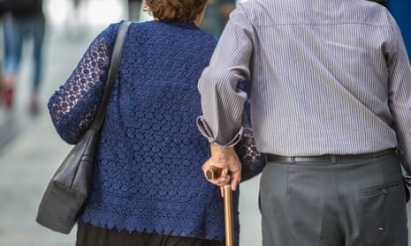
Thank you for your attention!
Szalma.ivett@tk.hu

