Slide 1
The strategic use referendums in Hungary
The case of the 2022
Referendum on “Child Protection”
Daniel Oross, PhD
Case Study Meeting Cluj OCT 11-12
Cost Action 'LGBTQI+ Social and Economic (In)equalities
The Reproductive Sociology Research Group, supported by the Momentum Programme of the Hungarian Academy of Sciences

Slide 2
Aim and content of the presentation
The aim of this presentation is to provide a mini-case study of a controversial aspect related to LGBTQ+ social rights exercised in practice in Hungary.
The 2022 referendum exclusively served the strategic interests of the Fidesz party: the party tried to advance its legislative agenda and it mobilized its supporters, therefore the main questions of the presentation are:
What were the characteristics of the legislative agenda of the government?
How did the government use the referendum to mobilize voters of the party in government (timeframe and tools)?

Slide 3
Act Nr. 79/2021 law on stricter action against pedophile offenders, as well as on the amendment of certain laws for the protection of children
Similarly to the bill signed by Vladimir Putin in 2013 prohibiting „homosexual propaganda” on the 15th June 2021 the Hungarian Parliament adopted Act LXXIX of 2021 on 'tougher action against paedophile offenders and amending certain laws to protect children’.
The law prohibits the promotion and display of homosexuality and gender reassignment to minors.
According to the Hungarian government it is necessary to protect children during their sexual development and that certain topics should be addressed at the appropriate age for their healthy psychological and mental development.

Slide 4

National Consultation 2021. 07.01-08.25
As a first step of legitimizing the law, the govenment included one question as part of its regular National Consultation series:
"Organizations financed by George Soros have launched a broad international attack against Hungary because of the law on the protection of children. This law prohibits sexual content propaganda directed at children in kindergartens, schools and media accessible to children. WHAT DO YOU THINK?
a, it is right that the law restricts sexual propaganda aimed at children
b, propaganda with sexual content aimed at children does not pose a risk, so it is unnecessary to ban it
Result: Based on the national consultation, the vast majority, 97 percent of the respondents support child protection measures.

Slide 5
9th amendment of the Fundamental Law of Hungary
On the 15th December 2021 the Parliament adopted the ninth amendment to the Basic Law, which states that
every child has the right to the protection and care necessary for their proper physical, mental and moral development. Hungary protects children's right to self-identity according to their birth sex, and ensures education according to the value system based on the country's constitutional self-identity and Christian culture.

Slide 6
Questions of the referendum
1. Do you support classes in public educational institutions on sexual orientation for minors without parental consent?
2. Do you support the promotion of sex reassignment treatments for minors?
3. Do you support the unrestricted presentation of sexual media content to minors that affects their development?
4. Do you support showing media content promoting gender reassignment to minors?
Source: https://vtr.valasztas.hu/nepszavazas2022
In Hungary, the national referendum is valid if more than half of all voters voted validly, and effective if more than half of the voters who voted validly gave the same answer to the formulated question.

Slide 7

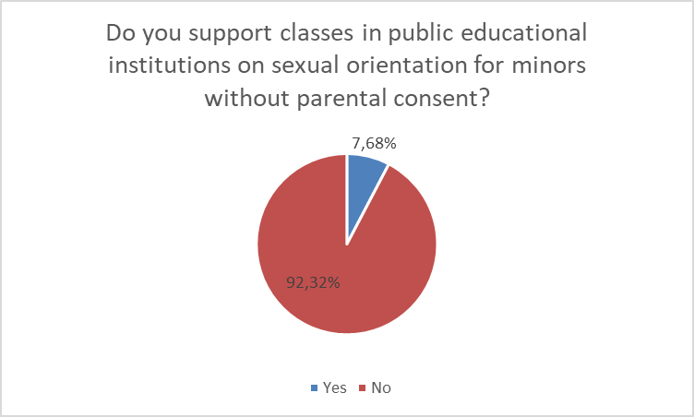
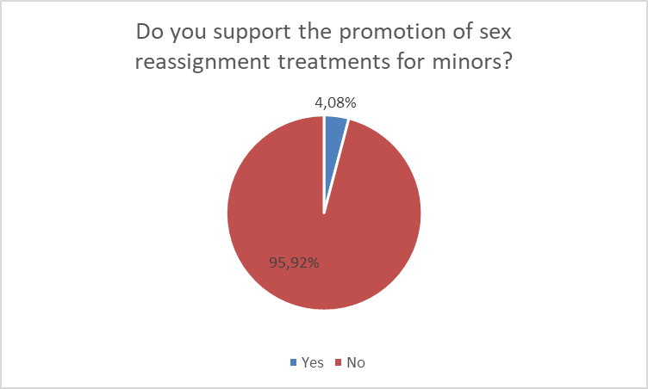
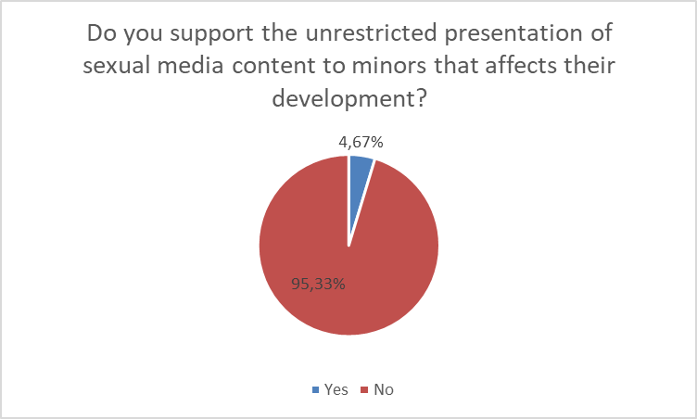
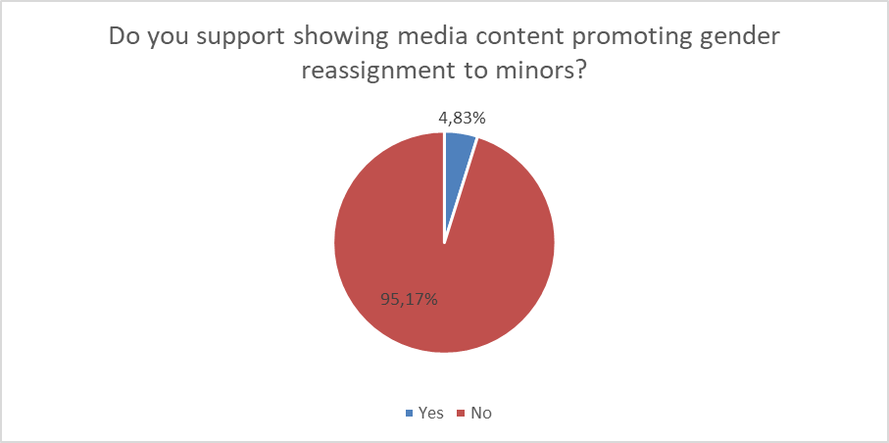
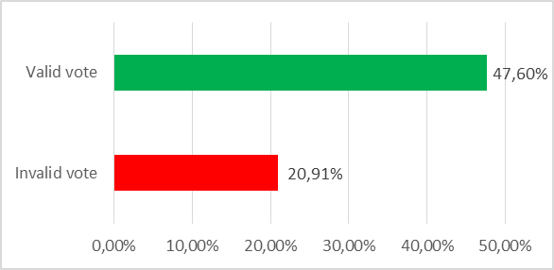
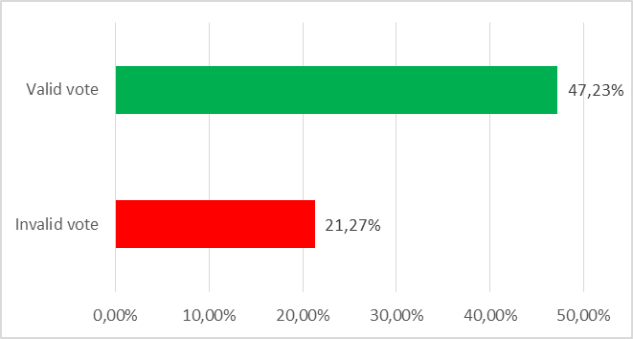
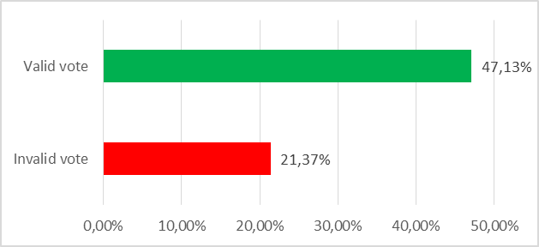
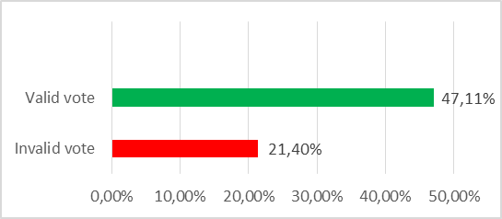
Turnout and Results
Source: https://vtr.valasztas.hu/nepszavazas2022
The child protection referendum was invalid in all four questions.

Slide 8
Discussion
Nationalist politicians like Viktor Orbán use the EU’s more liberal position towards LGBT rights to draw boundary between the ‚decadent West’ and the ‚traditional East’ for their own purposes.
The government wanted to legitimize the law on the amendment of certain laws for the protection of children voted in 2022 with a referendum, but the attempt failed.
Enormous mobilization and increase of support regarding one important political issue shows that the referendum was a highly effective political tool in the hands of the government, even if the turnout of the 2022 referendum was too low (47%) and, consequently, it was officially declared invalid.

Slide 9

Thank you for your attention!
The Reproductive Sociology Research Group, supported by the Momentum Programme of the Hungarian Academy of Sciences
Dániel Oross
oross.daniel@tk.hu

