Slide 1

Selective Pronatalism and Reproductive Autonomy: Attitudes Toward Medically Assisted Reproduction in Hungary
Ivett Szalma – Lóránt Pélyi
5th ISA Forum
6-11 July Rabat

Slide 2

Relevance
One of the central narratives promoted by the Hungarian government is that of the “demographic crisis,” which is intertwined with broader nationalist and conservative themes.
Eastern European Trends in 2010s:
Countries like Russia, Hungary, and Poland introduced pronatalist policies.
Emphasis on:
  Traditional family values (marriage, heteronormativity)
  Motherhood as a moral, patriotic, and economic duty
  Rejection of gender equality and LGBTQ rights (Bluhm & Brand, 2018; Lendvai-Bainton & Szelewa, 2020; Yatsik, 2020).

Slide 3
Theoretical consideration
🟢 Pronatalism (more general and inclusive):
Goal: Increasing birth rates through demographic incentives
Universal support measures (family allowances)
🔴 Nativism (more exclusionary and nationalist):
Rooted in nationalism and xenophobia (Mudde, 2007). Nativism asserts that a nation’s survival depends exclusively on the reproduction of its “native” population (Ennser-Jedenastik, 2021).
Goal: Promoting the reproduction of the "native" population.
Rejects migration as a demographic solution.
Uses women’s reproductive role as a tool for defending the nation. LGBTQ+ people are frequently blamed for low reproduction.
Links demography with cultural homogeneity.
At first glance, it might seem that pronatalism always supports the use of MAR.
However, this is not always the case, as in many instances, the state restricts access to MAR for certain groups, revealing underlying social or economic biases that shape who is deemed eligible for support in their path to parenthood (Compans & Zagel, 2025). SELECTIVE PRONTALISM
In certain Central and Eastern European countries, such as Hungary same-sex couples’ exclusion from MAR is explicitly part of a broader “selective patriotic pronatalist” agenda (Szalma & Takács, 2025).

Slide 4
MAR regulations
The regulation of MAR dates back 1981 – only those who are married.
A major shift occurred in the late 1990s when cohabiting heterosexual couples were granted access to MAR services.
Further reforms in the mid-2000s extended access to single women under 45, but lesbian couples in registered partnerships remained excluded.
Significant shifts occurred in 2020, when the government nationalized fertility clinics. Introducing state-funded support for treatments and medications.
Publicly funded IVF procedures available until a woman's 45th birthday (max 6 inseminations, 5 stimulated retrievals).
Currently, Hungary has 12 fertility centers, with 7 located in Budapest and 5 in major provincial cities.

Slide 5
Hypothesis: The Declining Population Narrative
Demographic decline has become a potent narrative underpinning institutionalized pronatalism, often framed as an existential crisis demanding urgent policy intervention.
This anxiety has been rearticulated under right-wing populist governance, framing demographic decline as a civilizational threat tied to the erosion of heteronormative family structures and national identity (Rasmussen, 2023).
H1a: Individuals who believe that childbearing is important due to Hungary’s population decline are more likely to support IVF for heterosexual couples.
H1b: Individuals who believe that childbearing is important due to Hungary’s population decline are less likely to support IVF access for lesbian couples.

Slide 6
Hypothesis: Endorsing Traditional Gender Roles
Our second hypothesis suggests that there may be an alignment of traditional gender values with the state’s pronatalist agenda:
H2a: Individuals who agree that the husband should prioritize work, while the wife should prioritize home and children, are more likely to support IVF for heterosexual couples.
H2b: Individuals who agree that the husband should prioritize work, while the wife should prioritize home and children are less likely to support IVF access for lesbian women.

Slide 7
Hypothesis: Voluntary Childlessness and the Limits of Reproductive Autonomy
The integration of MAR into state-led pronatalist agendas often raises concerns about reproductive autonomy.
Pronatalist discourses in Europe, particularly in Central and Eastern Europe, link voluntary childlessness to cultural threats framing as risks to national survival (Szalma & Heers, 2024).
H3a: Individuals who agree that childbearing is necessary for a woman to live a full life are more likely to support IVF for heterosexual couples.
H3b: Individuals who agree that childbearing is necessary for a woman to live a full life are less likely to support IVF access for lesbian couples.

Slide 8
Hypothesis: Pronatalist Policies as Alternatives to Migration in Addressing Demographic Decline
A fourth hypothesis reflects the belief that domestic pronatalist policies are the only acceptable demographic solution: immigration framing as risks to national survival (Szalma & Heers, 2024).
H4a: Individuals who assess immigration as having a “negative impact” on counterbalancing population decline are more likely to support IVF for heterosexual couples.
H4b: Individuals who assess immigration as having a “negative impact” on counterbalancing population decline are less likely to support IVF access for lesbian couple.

Slide 9
Data and Methods
Survey conducted Feb–Apr 2024 by Centre for Social Sciences (the “Momentum” Reproductive Sociology Research Group) https://reprosoc.tk.hu/en
N = 1,506, nationally representative (age, gender, settlement type)
Multistage stratified sampling + online & in-person data collection
Dependent variables: the acceptance of in-vitro fertilization for heterosexual couples? And the acceptance of lesbian couples' participation in IVF procedures.
Independent variables: „Childbearing is important because Hungary’s population is declining”, „It is correct that the husband should prioritize work, while the wife should prioritize home and children, even if both of them are employed”, „Childbearing is necessary for a woman to live a full life”, „The impact of people moving to Hungary from other countries to counterbalance the country’s population decline?”
Controlled for: gender, age, education, religiosity, marital status, parenthood status
Method: Logistic regression was chosen as the primary analytical method because it allows for the examination of binary outcomes

Slide 10
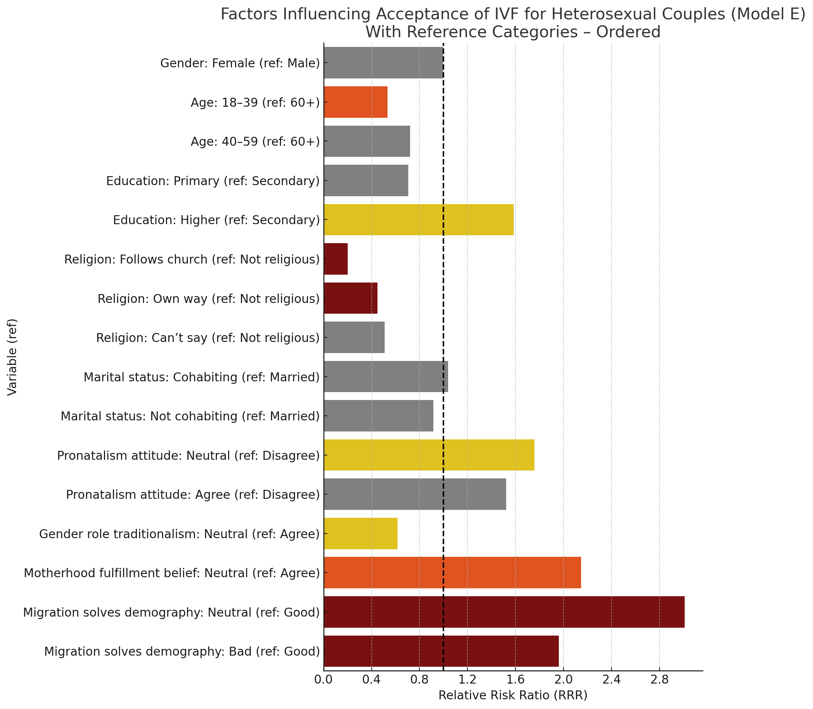
Results

Slide 11
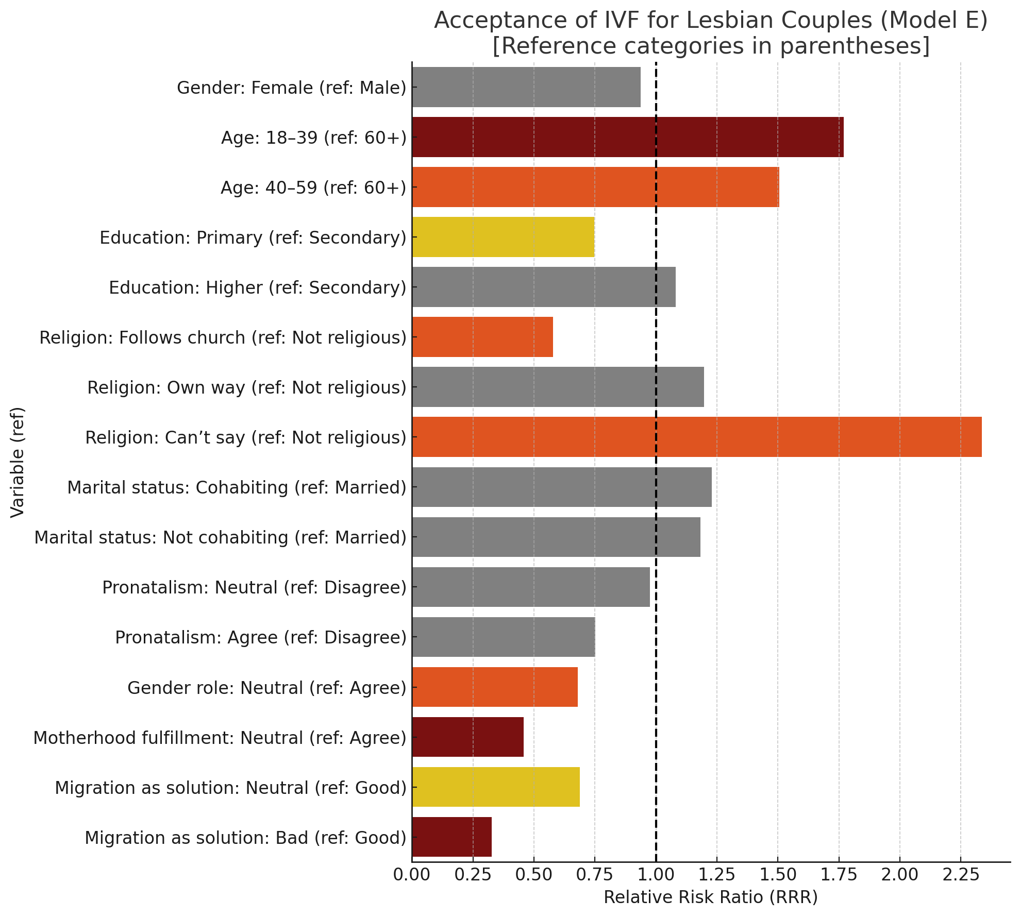
Results

Slide 12
Results

Slide 13
Summary:
Hypothesis | Statement | Result
H1a | Support for IVF for heterosexual couples increases with pronatalist attitudes (e.g., due to Hungary’s population decline) | Accepted
H1b | Support for IVF for lesbian couples decreases with pronatalist attitudes | Accepted
H2a | Traditional gender role attitudes predict higher support for IVF for heterosexual couples | Rejected
H2b | Traditional gender role attitudes predict lower support for IVF for lesbian couples | Accepted
H3a | Belief that childbearing is necessary for a woman’s full life increases support for IVF for heterosexual couples | Accepted
H3b | Disagreement with the motherhood norm increases support for IVF for lesbian couples | Accepted
H4a | Negative or neutral attitudes toward immigration predict higher support for IVF for heterosexual couples | Accepted
H4b | Negative or neutral attitudes toward immigration predict lower support for IVF for lesbian couples | Accepted

Slide 14
Conclusion:
Political framing shapes attitudes: Populist rhetoric links IVF access to demographic fears and traditional family norms.
Selective pronatalism: IVF is supported mainly for heterosexual couples; lesbian couples face exclusion under ideologically driven reproductive policy.
National identity over diversity: Reproductive support is often granted to those seen as contributing to the “native” population.
Conservative attitude syndrome: Support for traditional gender roles, anti-migration views, and nationalism strongly correlate with IVF rejection for same-sex couples.
Policy implications: MAR regulations can reinforce exclusion, restricting reproductive autonomy.

Slide 15
Conclusion:
This paper is coming soon!
Szalma, Ivett – Pélyi, Lóránt (2025). Selective Pronatalism and Reproductive Autonomy: Attitudes Toward Medically Assisted Reproduction in Hungary. Social Inclusion, Vol:13
https://doi.org/10.17645/si.10390

Slide 16
Thank you for your attention!
Szalma.ivett@tk.hu

