Slide 1



Measuring attitudes towards voluntary childlessness: Indicators in European comparative surveys
Ivett Szalma, Marieke Heers, Maria Letizia Tanturri

Slide 2
Attitudes Toward Voluntary Childlessness in Europe: Trends, Influences, and Measurement
Traditional Norms: Parenthood has long been viewed as essential for a fulfilling life, with societal stigma around childlessness, especially for women.
Cultural Shifts: Since the 1960s, emphasis on self-fulfillment, secularization, and gender equality has transformed parenthood into a choice rather than an obligation (Peterson, 2015).
Technological Impact: Reliable contraceptives (post-1970s) enabled women to separate sexuality from motherhood, increasing visibility of voluntary childlessness (Sobotka, 2017).
Research Insights:
Attitudes vary by country and gender, with mixed findings on societal expectations (e.g., stronger pressure on women vs. acceptance of male childlessness).
Existing studies often yield contradictory results due to unclear item wording and overlooked dimensions of childlessness.
Study Aims:
Identify factors shaping attitudes toward voluntary childlessness.
Compare two survey measures to assess if they capture the same dimension of acceptance.

Slide 3
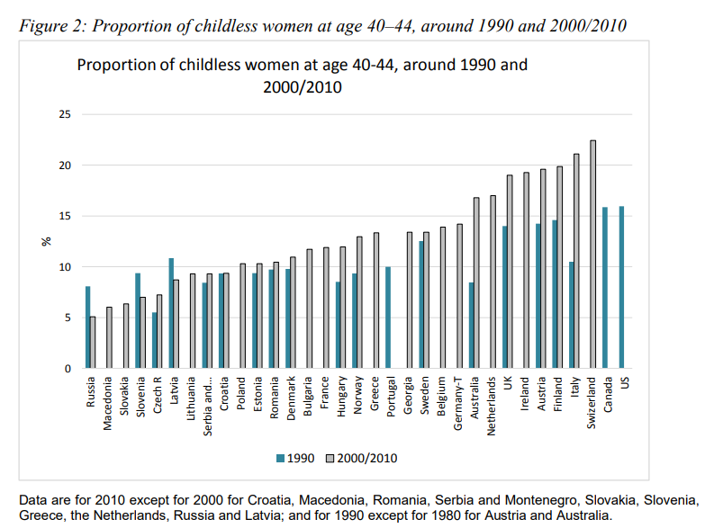
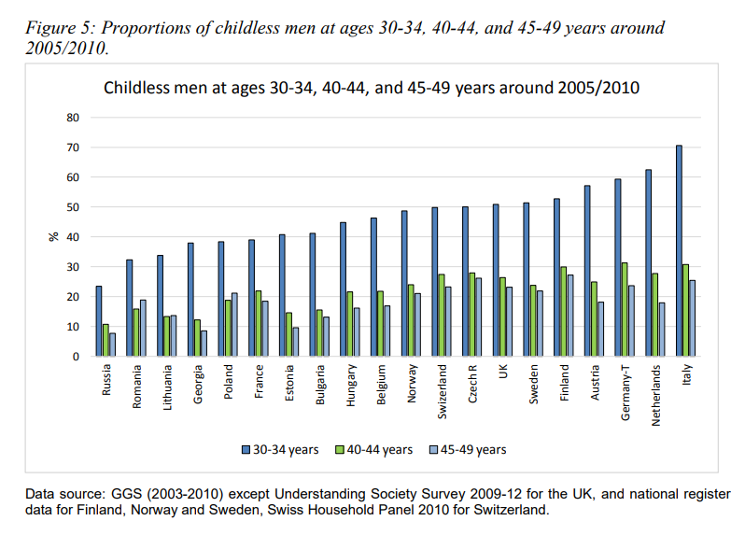
Childlessness rate
Lowest Childlessness Rates:
  Found in Eastern European nations (e.g., Russia, Macedonia, Slovakia).
Highest Childlessness Rates:
  Observed in Western and Northern European countries (e.g., Finland, Switzerland, Austria).
  Applies to both men and women
Between 1990 and 2010: Increasing trend in childlessness in all observed countries (except Russia, Slovenia and Latvia)
Source: Miettinen et al., 2015
Source: Miettinen et al., 2015

Slide 4
Theoretical framework

Slide 5
The various forms of childlessness
1) Lifetime/Permanent Childlessness:
  No biological/adopted children by end of reproductive years.
    Heterogeneous experiences (temporal, motivational, normative)(Szalma & Takács, 2015).
2) Social Parenting:
  Non-biological/non-legal parental roles (often overlooked in surveys)(Bures et al., 2009).
3) Voluntary vs. Involuntary:
  Voluntary: Active choice to reject parenthood.
  Involuntary: Barriers like medical issues, finances, or relationships.
Challenges in Defining Childlessness
Blurred Decision-Making: Postponement → unintended childlessness; medical/societal barriers (e.g., same-sex couples)(Szalma et al., 2022).
Binary Model Limitations: Oversimplifies (voluntary/involuntary), ignoring postpones and structural barriers.

Slide 6

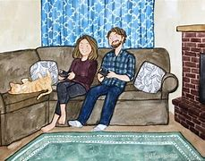
Prescriptive vs. Proscriptive Attitudes Toward Voluntary Childlessness
Prescriptive Attitudes
Reflect societal expectations of parenthood.
Emphasize parenthood as essential for fulfilment and social responsibility.
Example (ESS): “How much do you approve/disapprove if a woman/man chooses never to have children?”
Linked to stigma and social punishment for non-compliance (Koropeckyj-Cox & Pendell, 2007).
Proscriptive Attitudes
Focus on perceived disadvantages of childlessness.
Highlight negative evaluations of voluntary childlessness.
Example (EVS): “A woman/man has to have children to be fulfilled.”
Suggests childlessness leads to an unfulfilled life (Shapiro, 2014).

Slide 7
Theories on Voluntary Childlessness
New Home Economics
Rising opportunity costs of childbearing as women enter the labour market (Becker, 2009).
  Rising opportunity costs → women more supportive of voluntary childlessness than men.
  Higher education → More accepting attitudes towards childlessness
  Employment status → Less traditional views on childlessness.
2. Gender Revolution Theory
Transition from male-breadwinner to egalitarian dual-earner models.
  Higher societal gender equality → More accepting attitudes toward childlessness (Rijken & Merz, 2014).
3. Second Demographic Transition (SDT) Theory (Lestahaege & Van de Kaa, 1986)
Shift to post-materialistic values (self-realization, autonomy) replacing religious norms.
  Secularization → Greater acceptance of childfree lifestyles.
  Younger generations prioritize autonomy over traditional family roles.
  Marital status: Cohabitation → More accepting; Marriage/Widowed → More traditional.

Slide 8
Measurement of Attitudes Toward Voluntary Childlessness
International Surveys
ISSP (1988, 1994, 2002):
  Item: “People who have never had children lead empty lives.”
EVS (2001, 2008):
  Item: “Does a woman/man need children to be fulfilled?”
ESS (2018):
  Item: “How much do you approve/disapprove if a woman/man chooses never to have children?”
Attitudes Toward Male vs. Female Voluntary Childlessness
Gender Discrepancy:
  Voluntary childlessness is more stigmatized for women than men.
  Society less disapproving of male childlessness despite the lesser impact of parenthood on men’s lives.
Double Standards (Rijken & Merz, 2014)
  Behaviours judged differently based on social categories (e.g., gender). Harsher judgment for lower-status groups (e.g., women) vs. leniency for higher-status groups (e.g., men).

Slide 9
Data and method

Slide 10
Data
Data Sources
European Values Study (EVS) 2008-2010
European Social Survey (ESS) 2018
  27 European countries.
  Sample: Adults aged 18+.
Limitations
Ambiguity of survey items:
  Respondents’ interpretations of terms may vary.
Time gap: EVS (2008-2010) vs. ESS (2018).
Double standards unmeasurable

Slide 11
Dependent variables
Prescriptive Attitudes (ESS)
Item: “How much do you approve/disapprove if a woman/man chooses never to have children?”
Scale: 5-point Likert (1 = strongly disapprove; 5 = strongly approve).
Coding:
    Positive: Approve/Strongly Approve (1).
    Neutral/Negative: Disapprove/Strongly Disapprove (0).
Proscriptive Attitudes (EVS)
Item for Women: “Does a woman need children to be fulfilled?”
Scale: Binary (1 = not necessary; 0 = needs children).
Item for Men: “A man needs children to be fulfilled.”
Scale: 5-point Likert (1 = agree strongly; 5 = disagree strongly).
  Coding:
    Acceptance: Disagree/Strongly Disagree (1).
    Non-acceptance: Agree/Strongly Agree/Neutral (0).

Slide 12
Independent variables: Individual and country levels
Country-Level Variables
Childlessness rate:
  % of respondents aged 40+ without biological children (from EVS/ESS data).
Aggregated religiosity:
  Country mean of religious service attendance frequency.
Gender Inequality Index (GII):
  External indicator measuring women’s disadvantage in:
    Reproductive health, Empowerment, Labor market.
  Scale: 0 (equality) to 1 (max inequality).
  Years: GII 2008 (EVS) vs. GII 2018 (ESS).
Individual-Level Variables
Socio-Demographics:
  Gender (Male=1, Female=2)
  Age groups: 18–30, 31–45, 46–60, >60
  Education: Low, Medium, Degree
  Labor force status: Paid job, No paid job, Retired
  Partner status: No partner, Cohabiting, Married
  Parental status: Has children (1) vs. Childless (0)
  Religious attendance: From weekly to never.

Slide 13

Analytical strategy
Dependent Variables:
Three measured on an ordered scale.
One (EVS-item on women) measured as a dummy variable.
Data Transformation:
Likert-scale responses recoded into dummy variables:
  Approval of voluntary childlessness (approve/strongly approve = 1, disapprove/neutral = 0).
  "A man has to have children to be fulfilled" (disagree/strongly disagree = 1, others = 0).
  "A woman has to have children to be fulfilled" (not needed = 1, needed = 0).
Methodology:
  Multilevel logistic regression models.
Model Structure:
  Model A: Socio-demographic variables.
  Model B: Adds childlessness rate.
  Model C: Includes Gender Inequality Index (GII).
  Model D: Adds religious service attendance.

Slide 14
Results

Slide 15
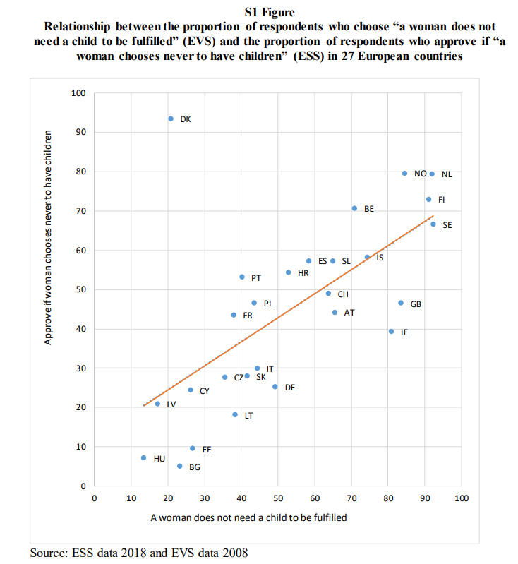
Descriptive results
Female childlessness:
Lowest Acceptance: Central Eastern Europe (CEE) for both female and male childlessness.
Highest Acceptance: Netherlands and Nordic countries (e.g., Norway, Sweden).
Middle Position: Southern Europe (e.g., Spain, Italy) and continental countries.
.

Slide 16
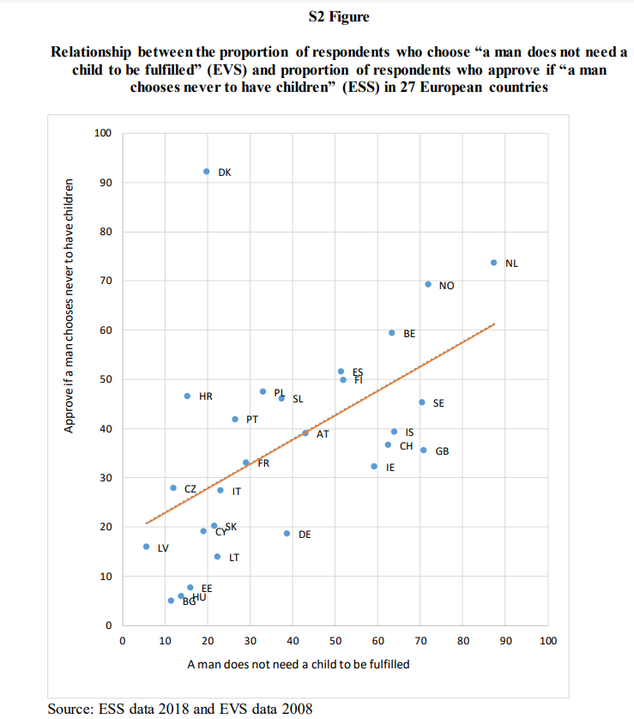
Descriptive results
Male childlessness:
  Northern countries: Greater variability in acceptance.
  Belgium: Highest prescriptive acceptance.

Slide 17
Results for individual level variables for items considering female and male voluntary childlessness
Socio-Demographics
Gender:
Women are more accepting than men.
Age:
Younger respondents (vs. >60) are more approving.
Education:
Higher education → More acceptance; lower education → Less acceptance.
Religiosity:
Regular religious service attendance → Less acceptance.
Employment Status:
Pensioners → Less accepting.
Unemployed (non-pensioners) → Less accepting (prescriptive dimension only).
Family Context
Partner Status:
Cohabiting (vs. married) → More accepting in both dimensions.
Single (vs. married) → More accepting in prescriptive dimension only.
Parental Status:
Childless respondents → More accepting than parents.

Slide 18

Country level variables
Childlessness Rates:
  Higher childlessness rates predict greater acceptance of voluntary childlessness in the prospective dimension.
  No significant association in the prescriptive dimension.
Gender Inequality Index (GII):
  Higher gender inequality goes together with less acceptance of both female and male voluntary childlessness in both dimensions.
  Religious Service Attendance:
  Aggregated attendance does not predict attitudes.

Slide 19
Conclusion
No Gender Difference in Attitudes
There is no significant difference in attitudes towards female and male voluntary childlessness.
Measurement of Attitudes Over Gender
The way attitudes are measured is more important than whether the question applies to men or women.
Varied Views Across Societies
Childless status is seen differently in various European societies.
Consideration of Non-Biological Parents
Future studies should focus on individuals without biological children but who have social/emotional connections to children.
Importance for Future Research
Understanding attitudes towards voluntary childlessness is crucial for family policy, especially as trends shift towards more people choosing to remain childless.
Need for Qualitative Studies
Qualitative studies should explore the concepts people have in mind to strengthen understanding of international comparisons.

Slide 20
References
Becker, G. (2009). Human capital: A theoretical and empirical analysis, with special reference to education (3rd ed.). University of Chicago Press.
Bures, R. M., Koropeckyj-Cox, T., & Loree, M. (2009). Childlessness, parenthood, and depressive symptoms among middle-aged and older adults. Journal of Family Issues, 30(5), 670–687. https://doi.org/10.1177/0192513X08331114
Koropeckyj-Cox, T., & Pendell, G. (2007). Attitudes about childlessness in the United States: Correlates of positive, neutral, and negative responses. Journal of Family Issues, 28(8), 1054–1082. https://doi.org/10.1177/0192513X07301940
Lesthaeghe, R., & Van de Kaa, D. J. (1986). Twee demografische transities? In D. J. Van de Kaa & R. Lesthaeghe (Eds.), Bevolking: Groei en krimp (pp. 9–24). Van Loghum Slaterus.
Miettinen, A., Rotkirch, A., Szalma, I., Donno, A., & Tanturri, M. L. (2015). Increasing childlessness in Europe: Time trends and country differences. Families and Societies, Working Paper Series, 3.
Peterson, H. (2015). Fifty shades of freedom: Voluntary childlessness as women's ultimate liberation. Women's Studies International Forum, 53, 182–191. https://doi.org/10.1016/j.wsif.2014.10.017
Rijken, A. J., & Merz, E. M. (2014). Double standards: Differences in norms on voluntary childlessness for men and women. European Sociological Review, 30(4), 470–482. https://doi.org/10.1093/esr/jcu051
Shapiro, G. (2014). Voluntary childlessness: A critical review of the literature. Studies in the Maternal, 6(1), 1–15. https://doi.org/10.16995/sim.9
Sobotka, T. (2017). Childlessness in Europe: Reconstructing long-term trends among women born in 1900–1972. In M. Kreyenfeld & D. Konietzka (Eds.), Childlessness in Europe: Contexts, causes and consequences (pp. 17–53). Springer.
Szalma, I., Hašková, H., Oláh, L., & Takács, J. (2022). Fragile pronatalism and reproductive futures in European post‐socialist contexts. Social Inclusion, 10(3), 82–86. https://doi.org/10.17645/si.v10i3.6128
Szalma, I., & Takács, J. (2015). Who remains childless? Unrealised fertility plans in Hungary. Sociologický Časopis, 51(6), 1047–1075.

Slide 21
Thank you for your attention!
Szalma.ivett@tk.hu

